Slide 1

Data Structures and Algorithms (ESO207)
Lecture 5:
More on Proof of correctness of an algorithm
Design of O($n$) time algorithm for Local Minima in a grid

Slide 2
Proof of Correctness

Slide 3
What does correctness of an algorithm mean ?
For every possible valid input,
the algorithm must output correct answer.
Let us take a toy algorithm ☺

Slide 4
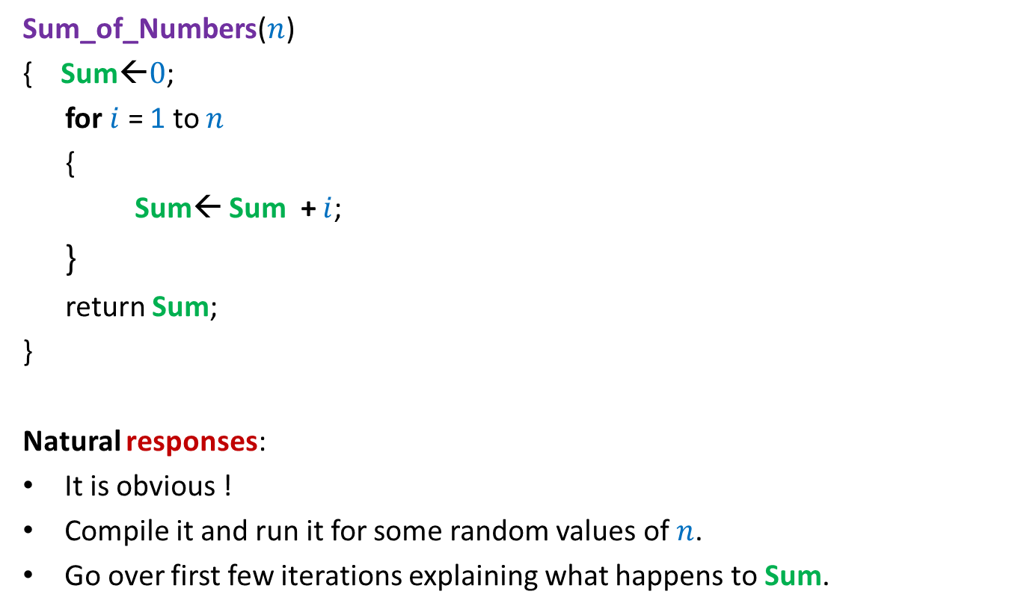

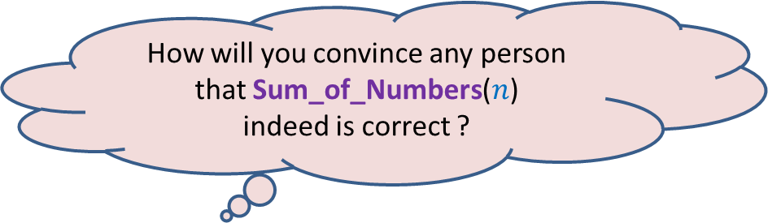
Algorithm for computing sum of numbers from $0$ to $n$
Sum_of_Numbers($n$)
{ Sum←$0$;
for $i$ = 1 to $n$
{
Sum← Sum + $i$;
}
return Sum;
}
Natural responses:
It is obvious !
Compile it and run it for some random values of $n$.
Go over first few iterations explaining what happens to Sum.
How will you convince any person that Sum_of_Numbers($n$)
indeed is correct ?

Slide 5
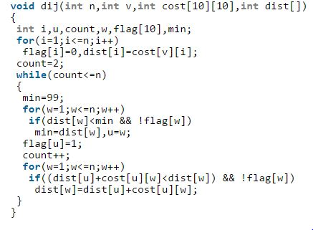
How will you respond
if you have to do it for the following code ?

Slide 6
Think for some time to realize
the non-triviality
the Importance
of proof of correctness of an iterative algorithm.
Interestingly, such a proof will be just
Expressing our intuition/insight of the algorithm
In the following slide, we present an overview of the proof of correctness.
in a formal way ☺.

Slide 7




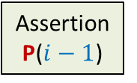
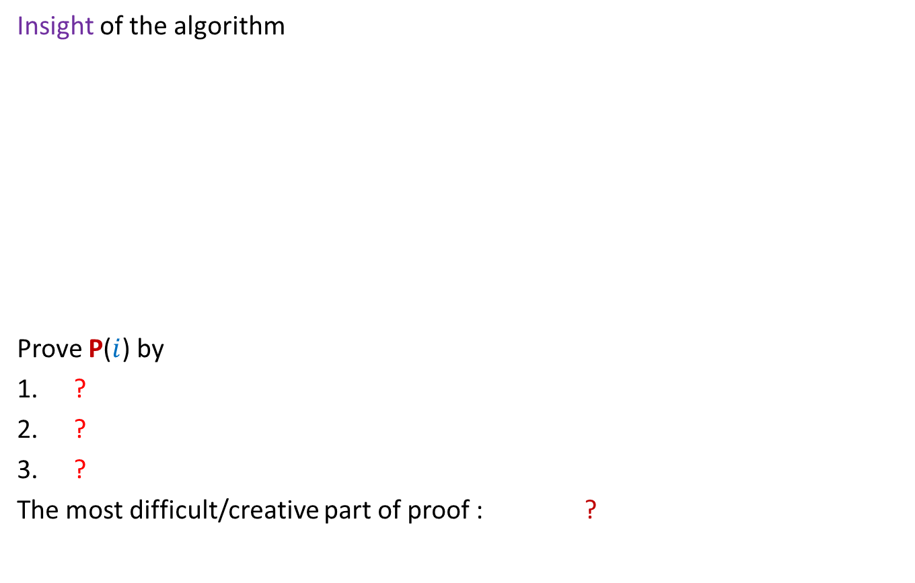

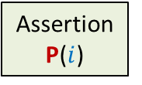





Proof of correctness
For an iterative algorithm
Insight of the algorithm
Prove P($i$) by
?
?
?
The most difficult/creative part of proof : ?
Theorem
Assertion
P($i−1$)
Assertion
P($i$)
Start
of Loop
$$i−1$$
$$i$$
Iterations
$$1$$
$$2$$
$$3$$
$$4$$
What would you expect at the end of $i$th iteration ?
Assuming P($i−1$)
Theorem
Proof by induction
Body of the Loop
To come up with the right assertion P($i$)

Slide 8
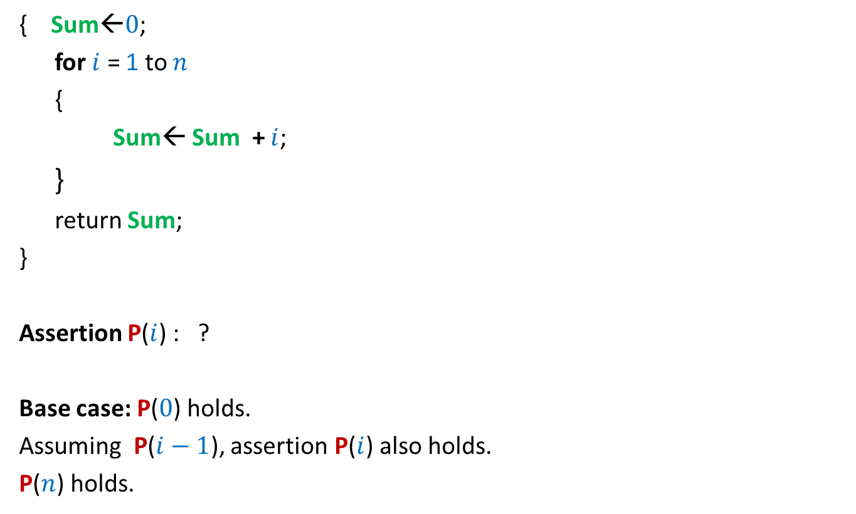
Algorithm for computing sum of numbers from $0$ to $n$
{ Sum←$0$;
for $i$ = 1 to $n$
{
Sum← Sum + $i$;
}
return Sum;
}
Assertion P($i$) : ?
Base case: P($0$) holds.
Assuming P($i−1$), assertion P($i$) also holds.
P($n$) holds.
At the end of $i$th iteration Sum stores the sum of numbers from $0$ to $i$.

Slide 9
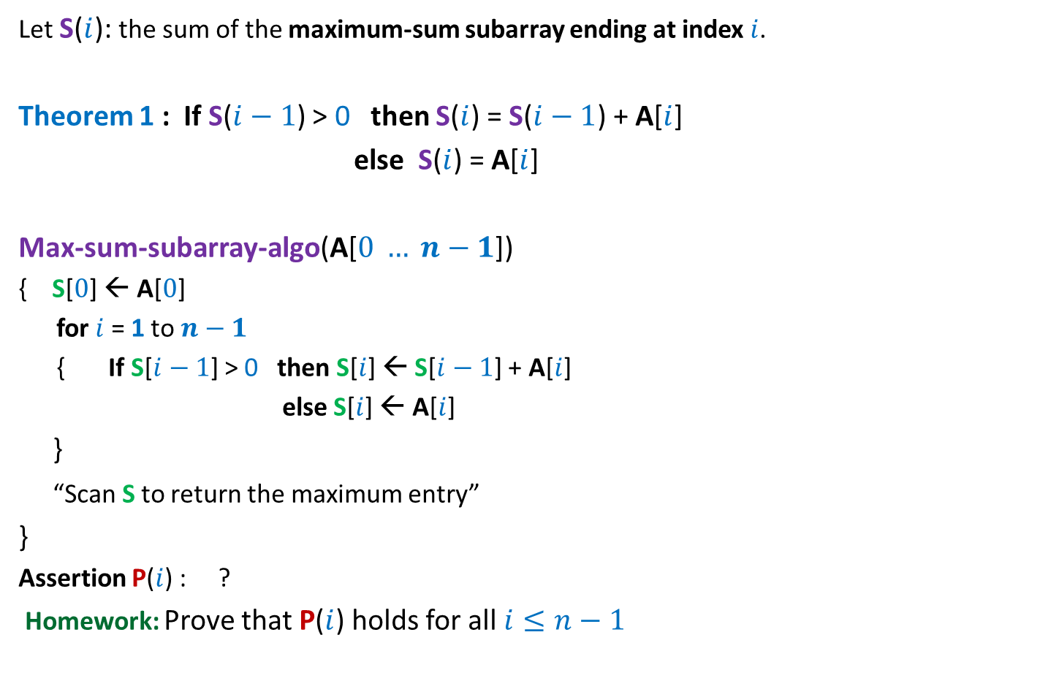
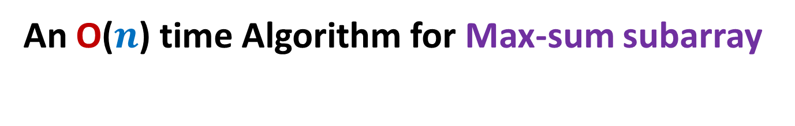
An O($n$) time Algorithm for Max-sum subarray
Let S($i$): the sum of the maximum-sum subarray ending at index $i$.
Theorem 1 : If S($i−1$) > 0 then S($i$) = S($i−1$) + A[$i$]
else S($i$) = A[$i$]
Max-sum-subarray-algo(A[$0 … n−1$])
{ S[$0$] ← A[$0$]
for $i$ = 1 to $n−1$
{ If S[$i−1$] > 0 then S[$i$] ← S[$i−1$] + A[$i$]
else S[$i$] ← A[$i$]
}
“Scan S to return the maximum entry”
}
Assertion P($i$) : ?
Homework: Prove that P($i$) holds for all $i≤n−1$
S[$i$] stores the sum of maximum sum subarray ending at A[$i$].

Slide 10
Local minima in a GRID

Slide 11



Local minima in a grid
Definition: Given a $n$× $n$ grid storing distinct numbers, an entry is local minima if it is smaller than each of its neighbors.
$$j$$
31
$$i$$
5
3
10
3
99

Slide 12


Local minima in a grid
Problem: Given a $n$× $n$ grid storing distinct numbers, output any local minima in O($n$) time.
$$j$$
31
$$i$$
5
3
10
3
99

Slide 13
Two simple principles
Respect every new idea which solves a problem even partially.
Principle of simplification:
If you find a problem difficult,
try to solve its simpler version, and then
extend this solution to the original (difficult) version.

Slide 14
A new approach
Repeat : if current entry is not local minima, explore the neighbor storing smaller value.
j
i
3

Slide 15
A new approach
Explore()
{ Let c be any entry to start with;
While(c is not a local minima)
{
c ← a neighbor of c storing smaller value
}
return c;
}

Slide 16

A new approach
Explore()
{ Let c be any entry to start with;
While(c is not a local minima)
{
c ← a neighbor of c storing smaller value
}
return c;
}
Worst case time complexity : O($n^{2}$)
How to apply this principle ?
First principle:
Do not discard Explore()
Second principle:
Simplify the problem

Slide 17


Local minima in an array
A local minima exists
in this region. Why ?
Theorem: There is a local minima in A[0,…, $i−1$].
Proof: Suppose we execute Explore() from A[$i−1$].
Explore(), if terminates, will return local minima.
It will terminate without ever entering A[$i$,…, $n−1$].
Hence there is a local minima in A[0,…, $i−1$].
23
17
9
A
9 17 23
$$i$$
Algorithmic proof

Slide 18
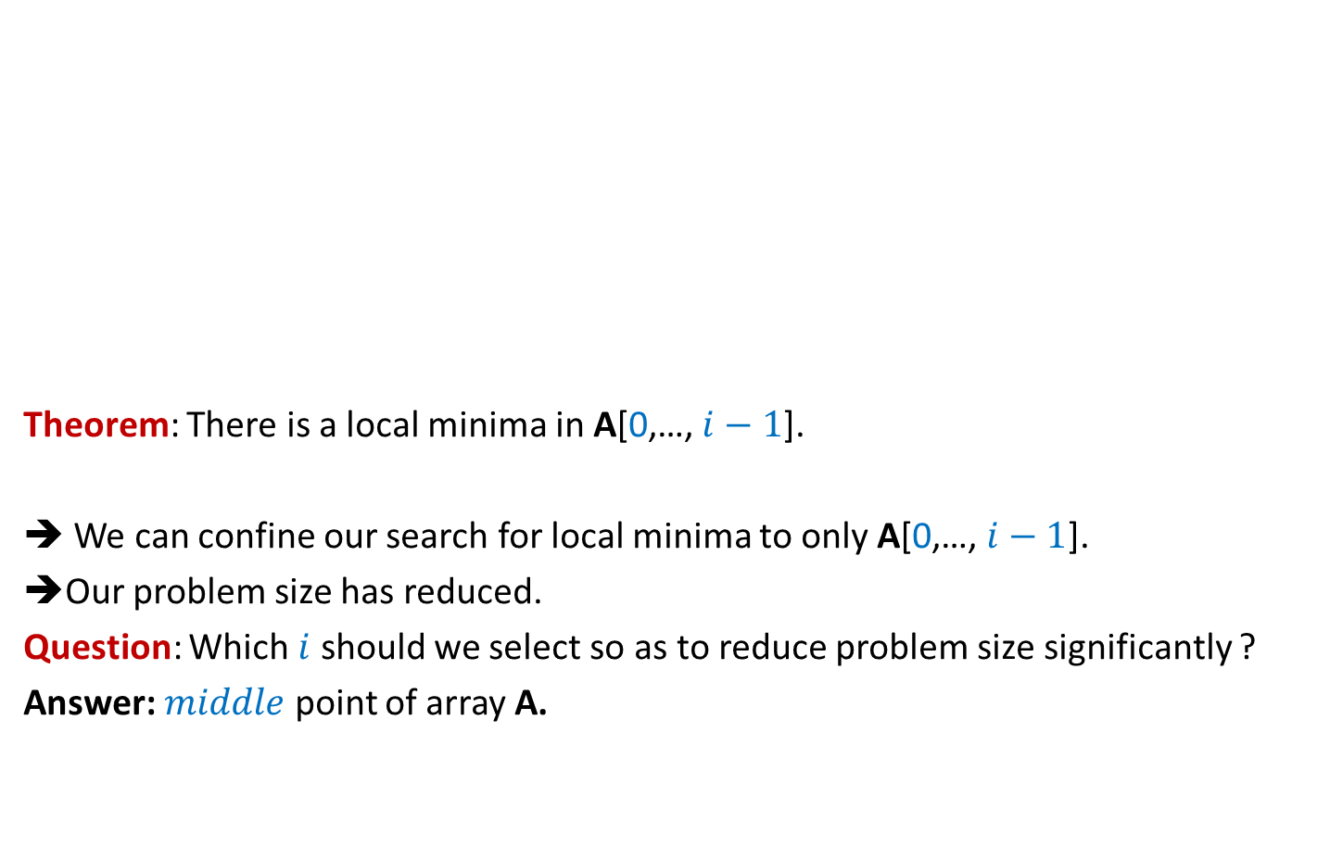
Local minima in an array
Theorem: There is a local minima in A[0,…, $i−1$].
➔ We can confine our search for local minima to only A[0,…, $i−1$].
➔Our problem size has reduced.
Question: Which $i$ should we select so as to reduce problem size significantly ?
Answer: $middle$ point of array A.
23
17
9
A
9 17 23
$$i$$

Slide 19

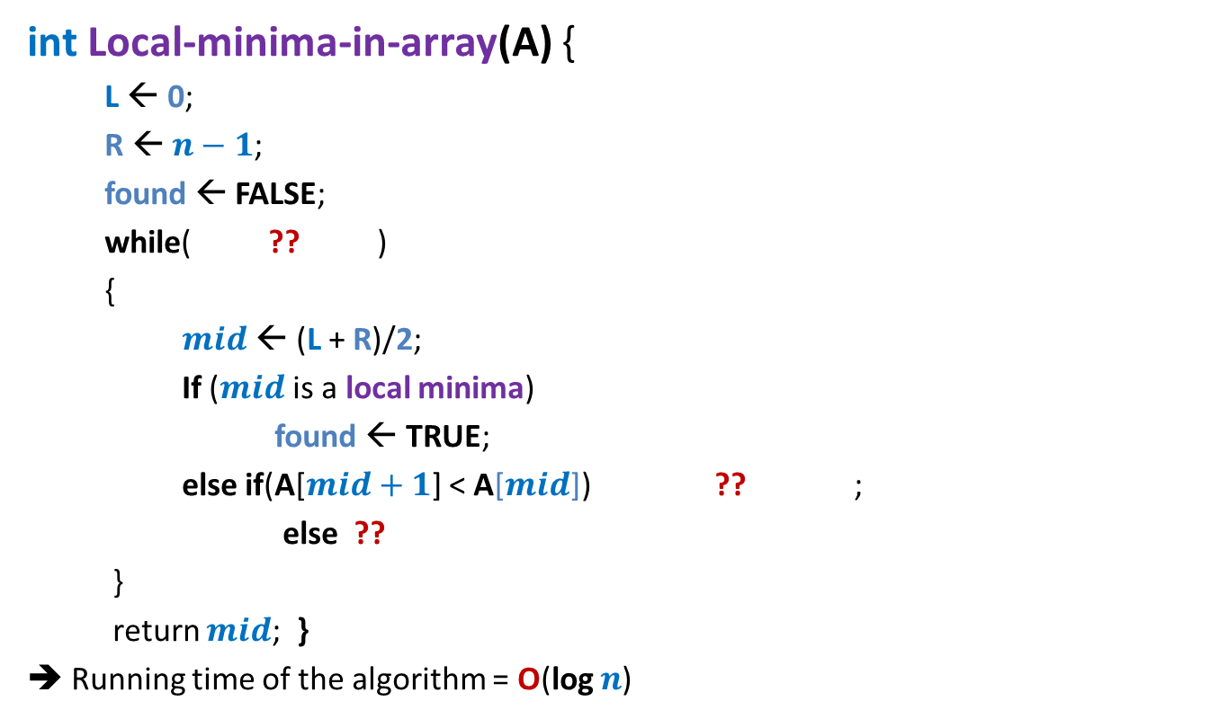

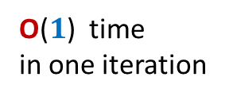

Local minima in an array (Similar to binary search)
int Local-minima-in-array(A) {
L ← 0;
R ← $n−1$;
found ← FALSE;
while( ?? )
{
$mid$ ← (L + R)/2;
If ($mid$ is a local minima)
found ← TRUE;
else if(A[$mid+1$] < A[$mid$]) ?? ;
else ??
}
return $mid$; }
➔ Running time of the algorithm = O(log $n$)
O(log $n$)
How many iterations ?
not found
O($1$) time
in one iteration
L← $mid+1$
R← $mid −1$
Proof of correctness ?

Slide 20


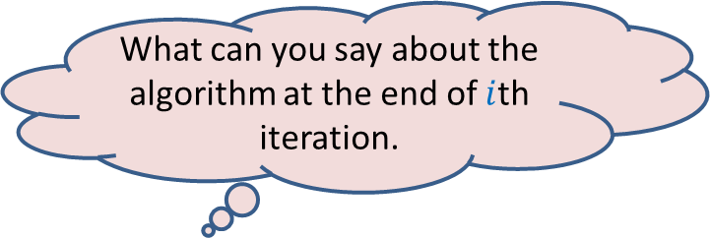

Local minima in an array (Proof of correctness)
What can you say about the algorithm at the end of $i$th iteration.
P($i$) : At the end of $i$th iteration,
“A local minima of array A exists in A[$L$,…, $R$].”
$$L$$
$$R$$
A

Slide 21
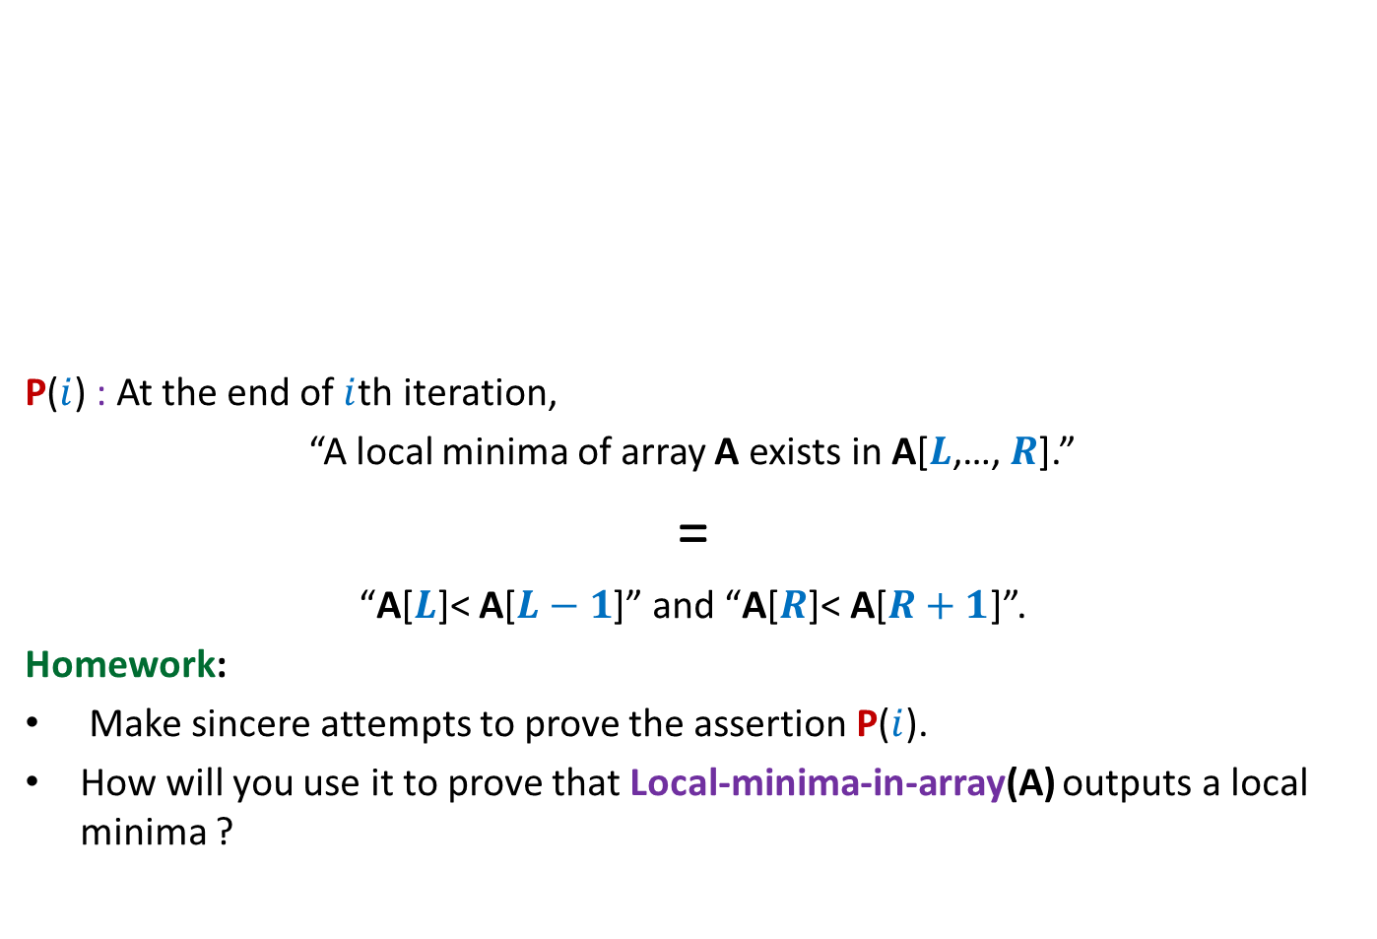
Local minima in an array (Proof of correctness)
P($i$) : At the end of $i$th iteration,
“A local minima of array A exists in A[$L$,…, $R$].”
=
“A[$L$]< A[$L−1$]” and “A[$R$]< A[$R+1$]”.
Homework:
Make sincere attempts to prove the assertion P($i$).
How will you use it to prove that Local-minima-in-array(A) outputs a local minima ?
$$L$$
$$R$$
A

Slide 22

Local minima in an array (Proof of correctness)
Theorem: A local minima in an array storing $n$ distinct elements
can be found in O(log $n$) time.

Slide 23

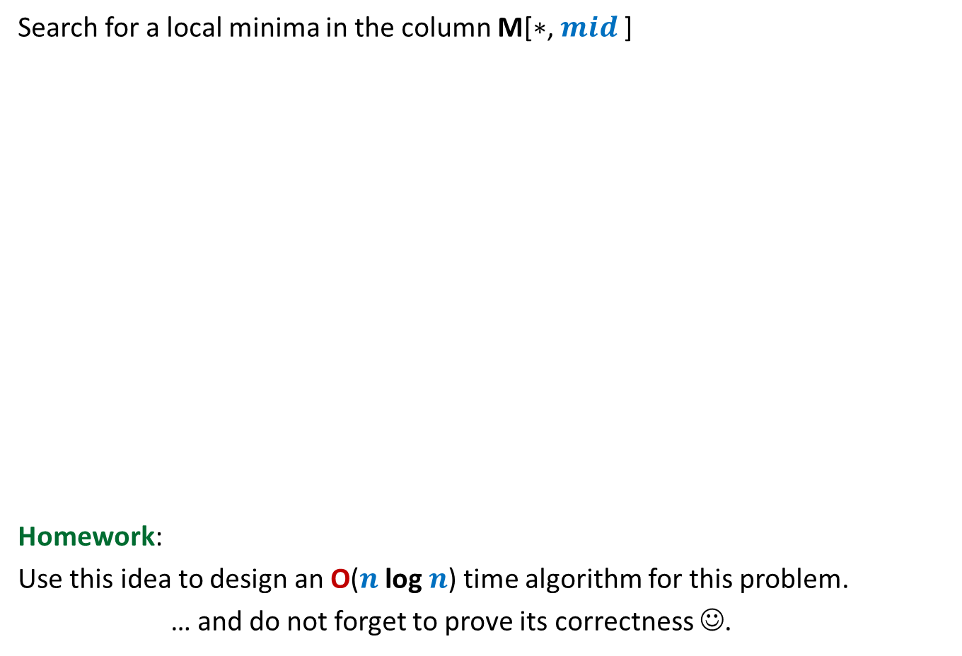

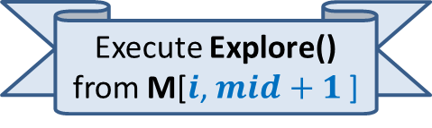
Local minima in a grid (extending the solution from 1-D to 2-D)
Under what circumstances even this smallest element is not a local minima ?
A local minima exists
in this region. Why ?
Search for a local minima in the column M[$∗$, $mid$]
Homework:
Use this idea to design an O($n$log $n$) time algorithm for this problem.
… and do not forget to prove its correctness ☺.
What if there is no local minima in the entire column.
$$mid$$
Smallest element
of the column
Execute Explore() from M[$i$, $mid+1$]
$$i$$
9
7

Slide 24
Make sincere attempts to
answer all questions raised in this lecture.

